Slide 1


LLM-Resilient Bibliometrics: Factual Consistency Through Entity Triplet Extraction
Alexander Sternfeld^{1, 2}, Dr. Andrei Kucharavy², Prof. Dr. Dimitri Percia David², Dr. Alain Mermoud¹ and Prof. Dr. Julian Jang-Jaccard¹
¹Cyber-defense Campus, armasuisse, Science and Technology ²Institute of Entrepreneurship Management, HES-SO Valais-Wallis

Slide 2
Today
1. Why look into LLM-generated articles?
2. Methodology
3. Results
4. Future steps

Slide 3
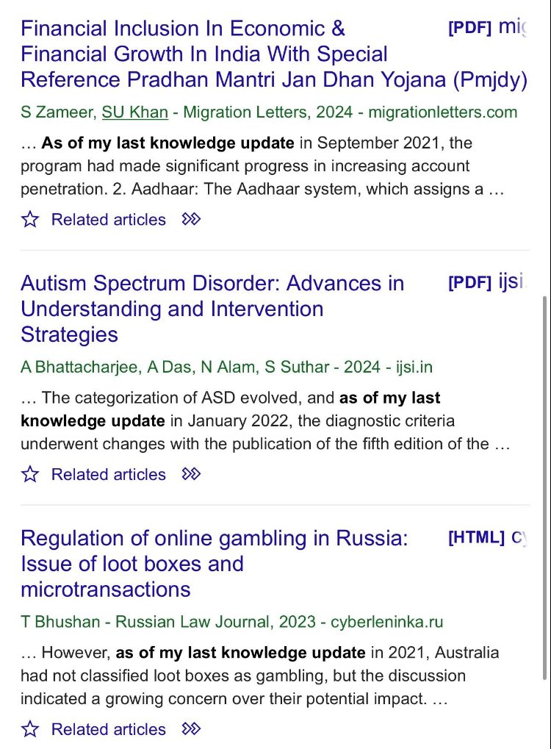
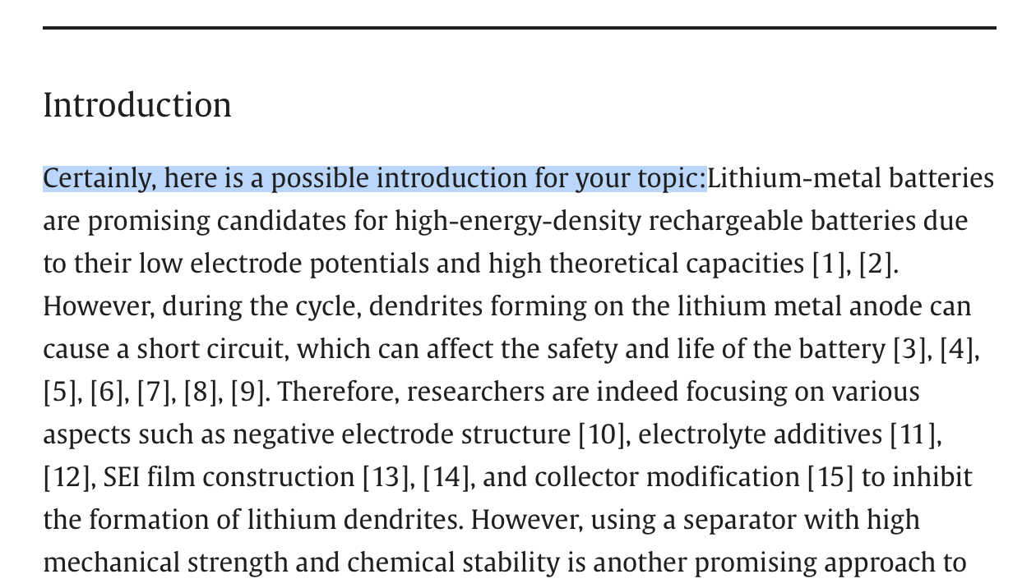
Why look into LLM-generated articles?

Slide 4
Detection of LLM-generated content
Detection of LLM-generated content has been an increasingly important research topic
Grover could detect its own output
However, recent work indicates that in a general setting, it is impossible to detect LLM-generated content (Henrique et al., 2023)
Detectors that seem effective can generally be evaded by a minimally competent attacker

Slide 5
The risks for bibliometric analysis
Bibliometrics often use large corpuses of papers scraped from the internet
Polluted data will throw off the findings
Potential for malicious agents to purposefully generate papers with specifically chosen keywords

Slide 6
Methodology
Infactual
Human-written
LLM-generated
Factual

Slide 7

Entity triplets
Goal: represent each scientific paper as a set of semantic entity triplets
Example triplets:
- (application, improve, poverty prediction) - (attack, threaten, infrastructure) - (application, require, ability) - (load balancing, yield, inference acceleration) - (large language model, exhibit, performance)

Slide 8
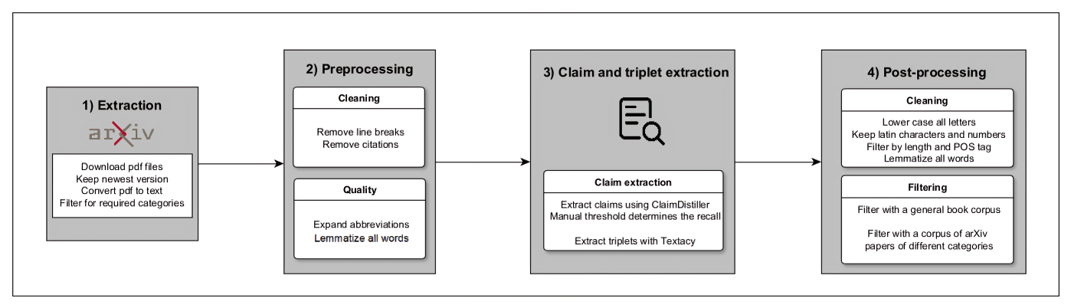
Methodology - 1

Slide 9
Methodology - 2
Claim extraction:
Use ClaimDistiller (Wei et al., 2023) to classify which sentences are claims
Makes subsequent triplet extraction easier
Triplet extraction:
We use Textacy, which is built on Spacy
Filtering:
Filter both on the Gutenberg book corpus and on 1000 arXiv papers from different categories

Slide 10
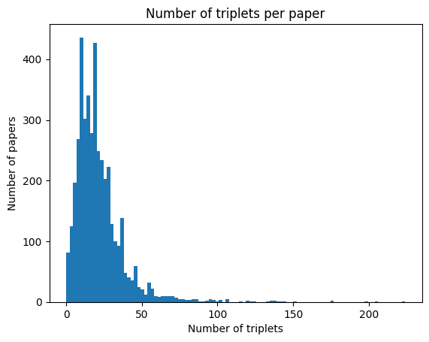
Results – triplet extraction
On average approximately 25 triplets per paper

Slide 11
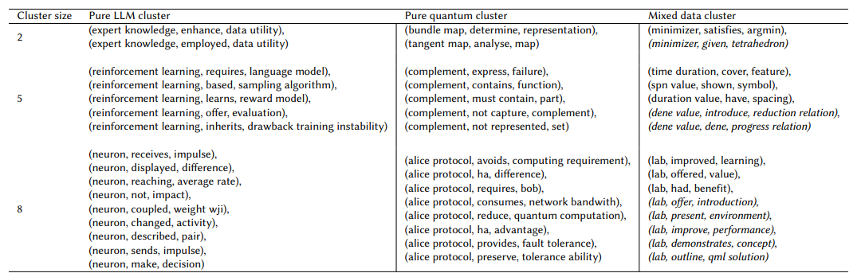
Results - clustering

Slide 12
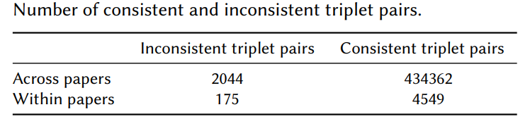
Factual consistency
As a first step towards factual consistency, we consider predicate comparisons
Classify pairs of predicates as synonyms, hyponyms, hypernyms or antonyms

Slide 13
Future steps
Main challenge: the triplet extraction pipeline needs to be refined to extract more domain-specific subjects and objects (e.g. lab and model are not sufficiently informative)
Potential directions:
Apply parameter-efficient fine-tuning (PEFT) on transformers for triplet extraction
Choose a graph perspective when using the current triplets

Slide 14
Thank you for your attention
I would be happy to answer any questions

Slide 15
References
C. Chen, K. Shu, Can llm-generated misinformation be detected?, 2023. http://dx.doi.org/10.2196/46924
D. S. G. Henrique, A. Kucharavy, R. Guerraoui, Stochas- tic parrots looking for stochastic parrots: LLMs are easy to fine-tune and hard to detect with other LLMs, 2023. http://arxiv.org/abs/2304.08968
X. Wei, M. R. U. Hoque, J. Wu, J. Li, Claimdistiller: Scientific claim extraction with supervised contrastive learning, in: C. Zhang, Y. Zhang, P. Mayr, W. Lu, A. Suominen, H. Chen, Y. Ding (Eds.), Proceedings of Joint Workshop of the 4th Extraction and Evaluation of Knowledge Entities from Scientific Documents (EEKE2023) and the 3rd AI + Informetrics (AII2023) co-located with the JCDL 2023, Santa Fe, New Mexico, USA and Online, 26 June, 2023, volume 3451 of CEUR Workshop Proceedings, CEUR-WS.org, 2023, pp. 65–77. URL: https://ceur-ws.org/Vol-3451/paper11.pdf

Slide 16
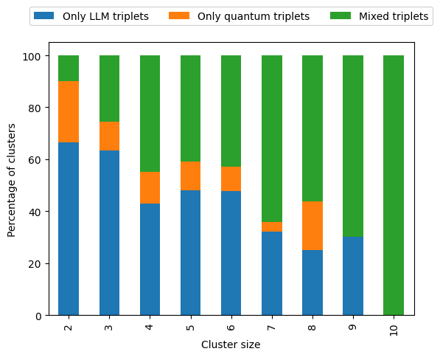
Results – clustering
To compare triplets for factual consistency, we cluster them based on the subjects
Larger clusters tend to be more domain-agnostic

